Slide 1

Library Management System
MPP Group 2
Issa Fikadu
Ashraf Elayed
Pat Adrian Limosnero

Slide 2
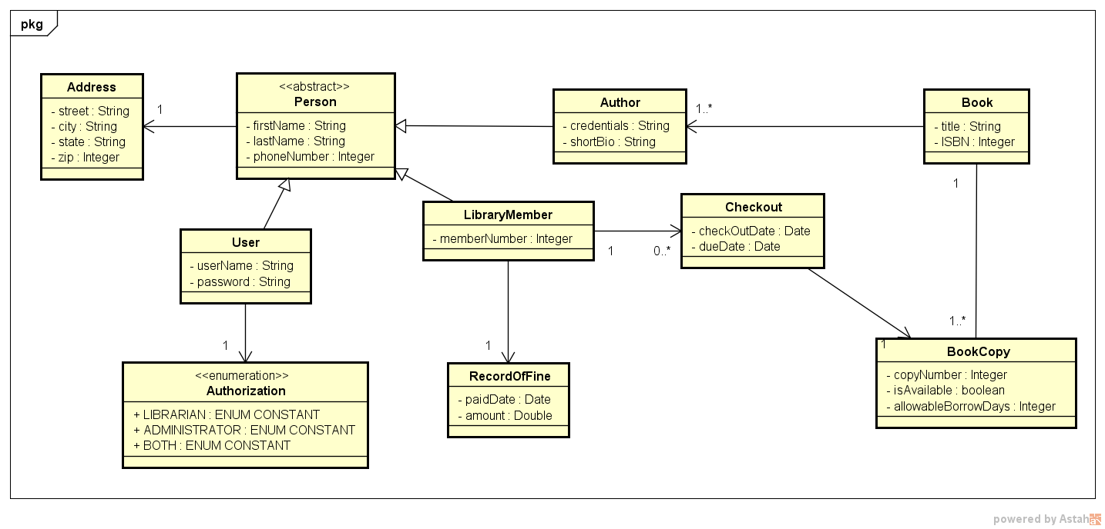
Class Diagram

Slide 3
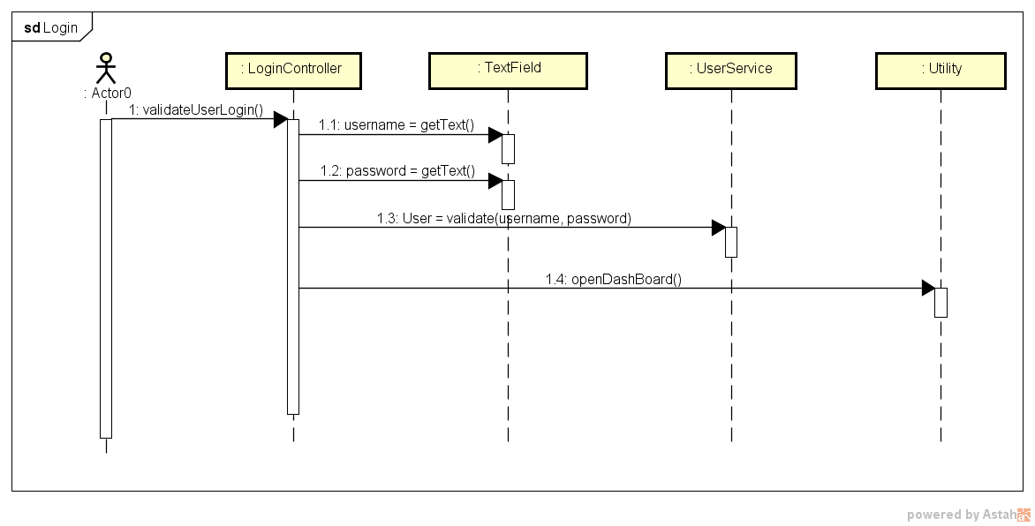
Sequence Diagram - Login

Slide 4
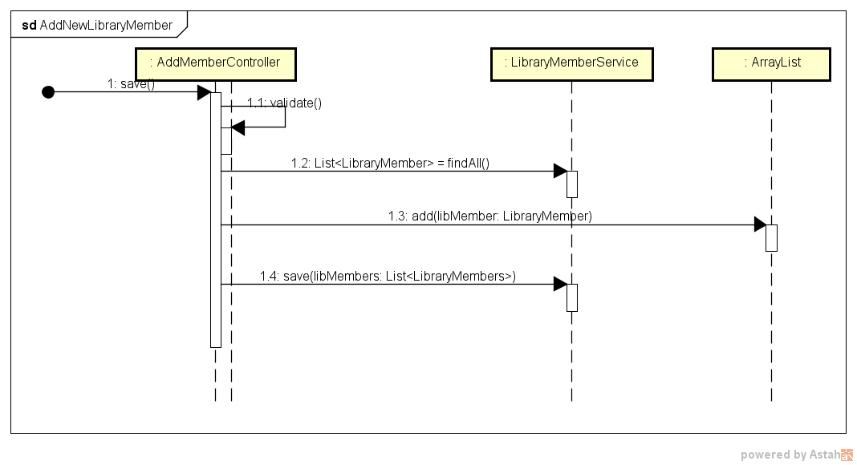
Sequence Diagram – Add New Library Member

Slide 5
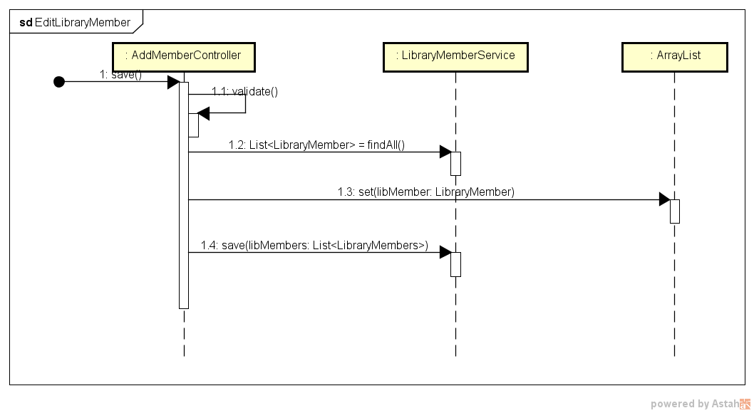
Sequence Diagram – Edit New Library Member

Slide 6
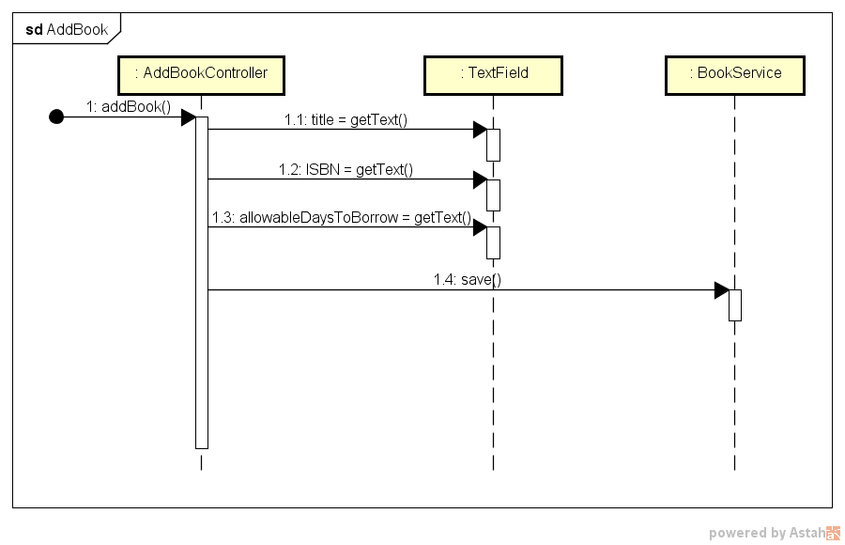
Sequence Diagram – Add Book

Slide 7
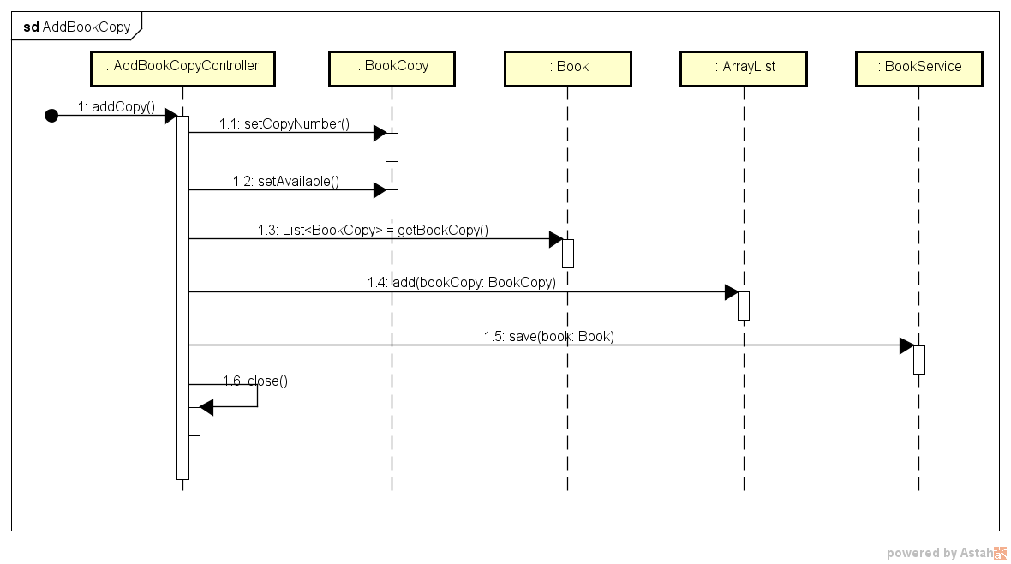
Sequence Diagram – Add Book Copy

Slide 8
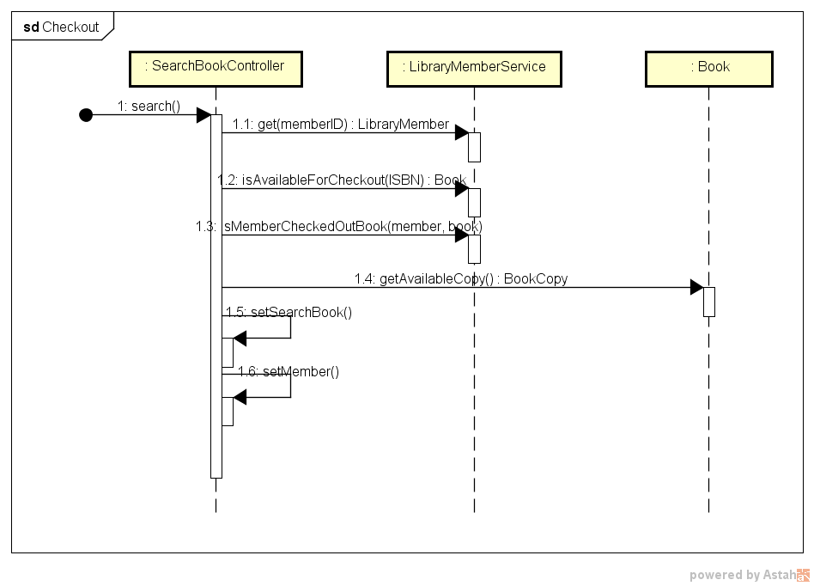
Sequence Diagram – Check Out Book

Slide 9
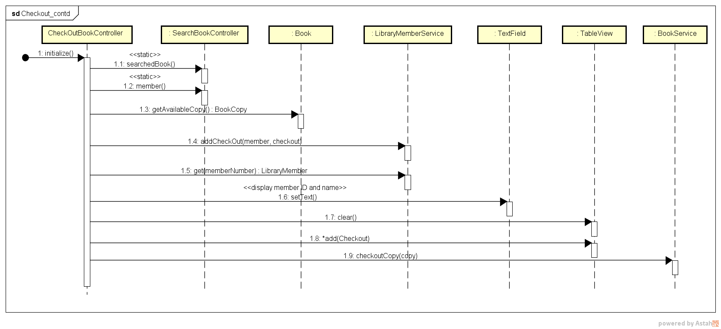
Sequence Diagram – Check Out Book (contd..)

Slide 10
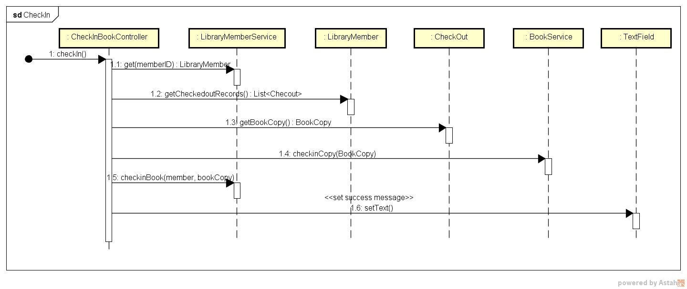
Sequence Diagram – Check In Book

Slide 11
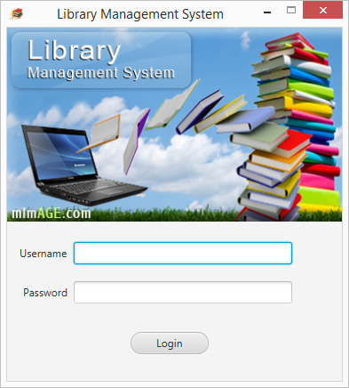
Screen Shot - Login

Slide 12
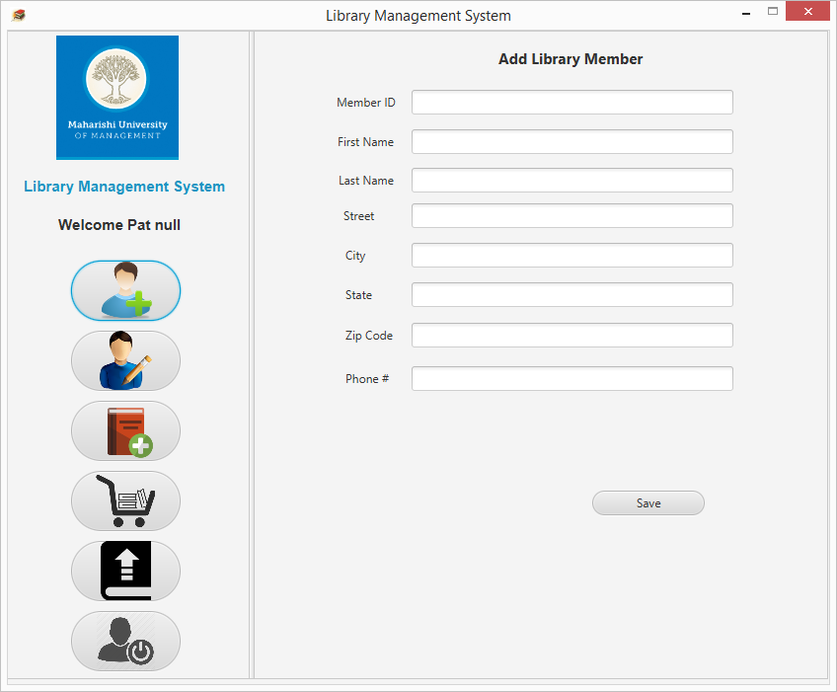
Screen Shot – Add New Library Member

Slide 13
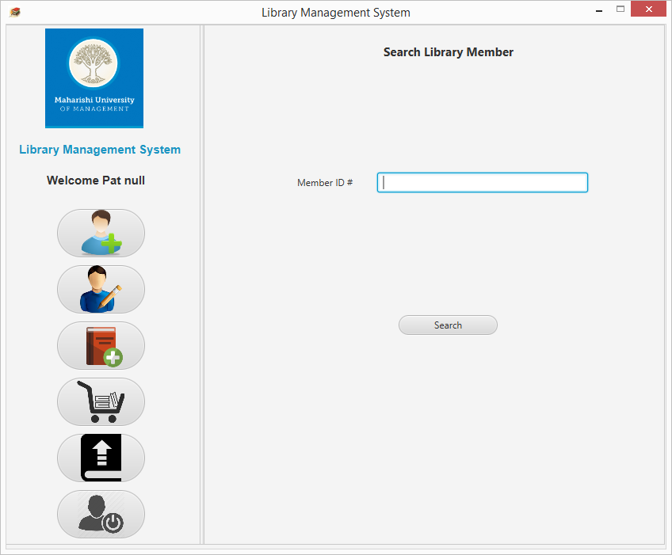

Screen Shot – Edit Library Member Information

Slide 14
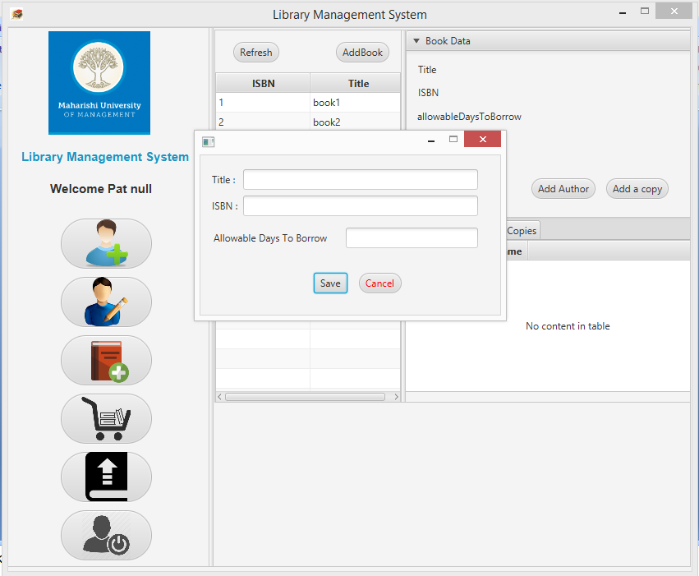
Screen Shot – Add Book

Slide 15
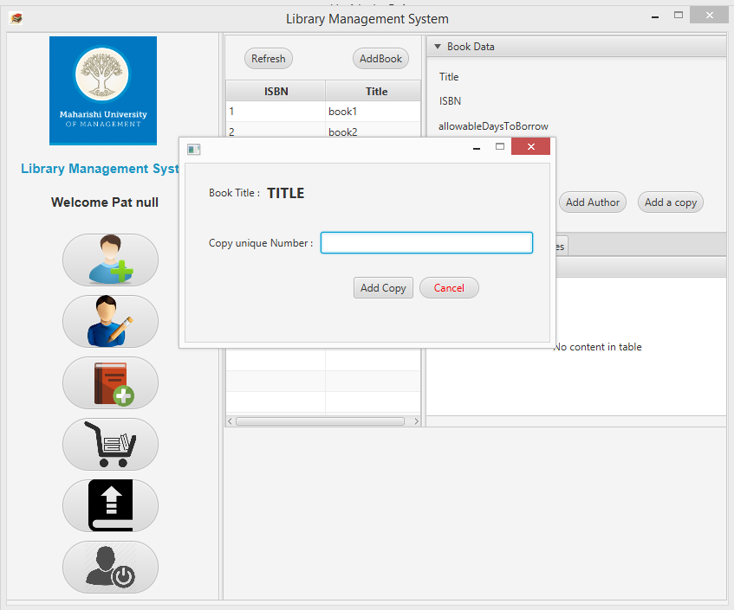
Screen Shot – Add Book Copy

Slide 16
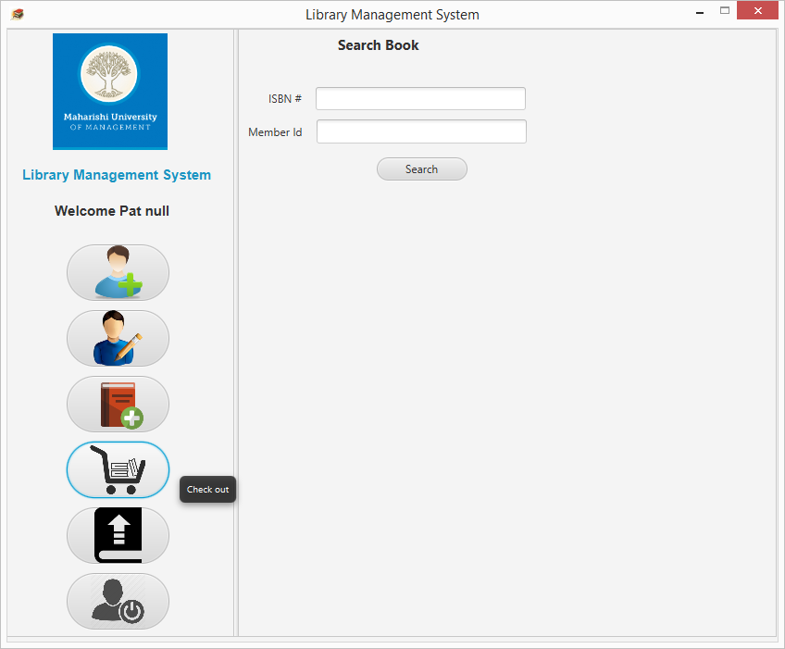
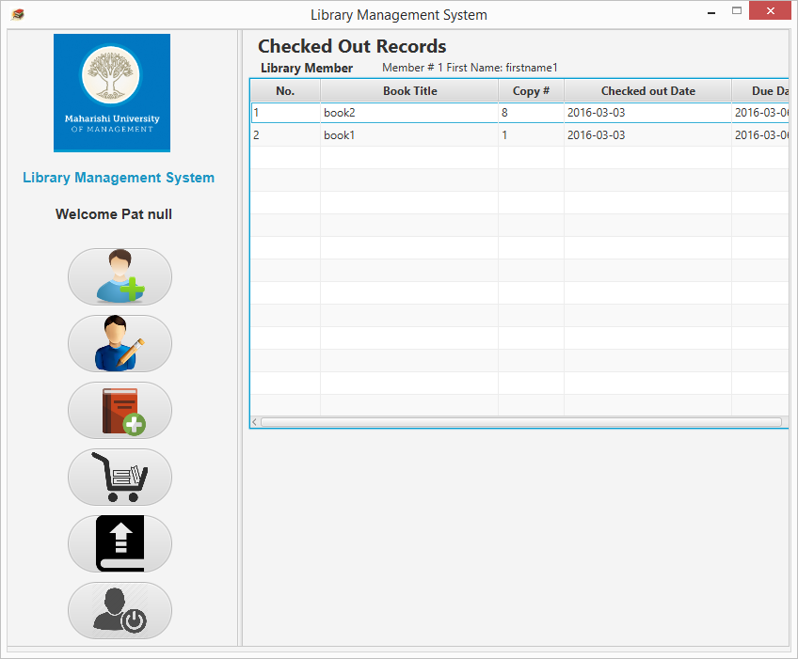
Screen Shot – Check Out Book

Slide 17
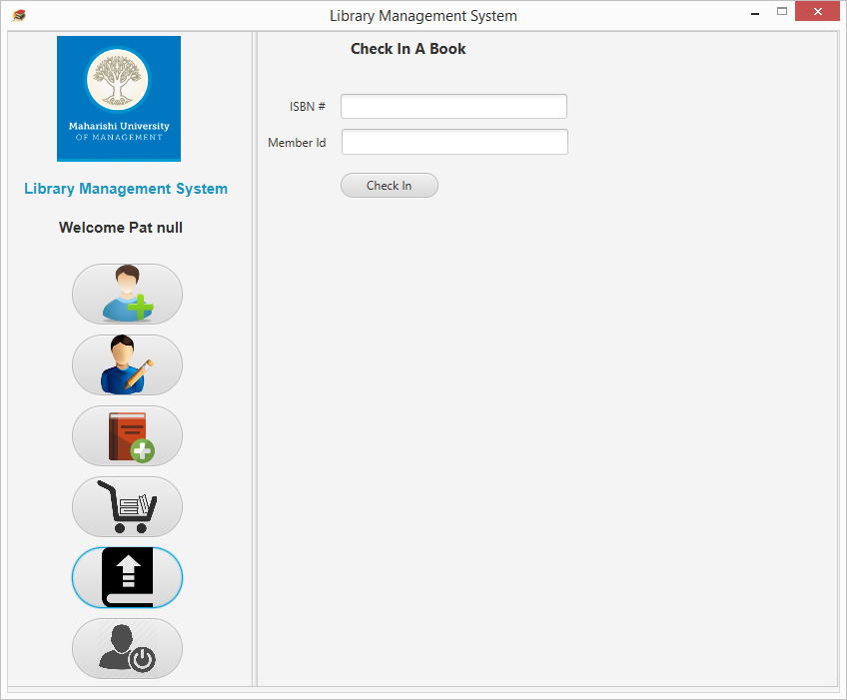
Screen Shot – Check In Book

Slide 18


Slide 19


